Slide 1
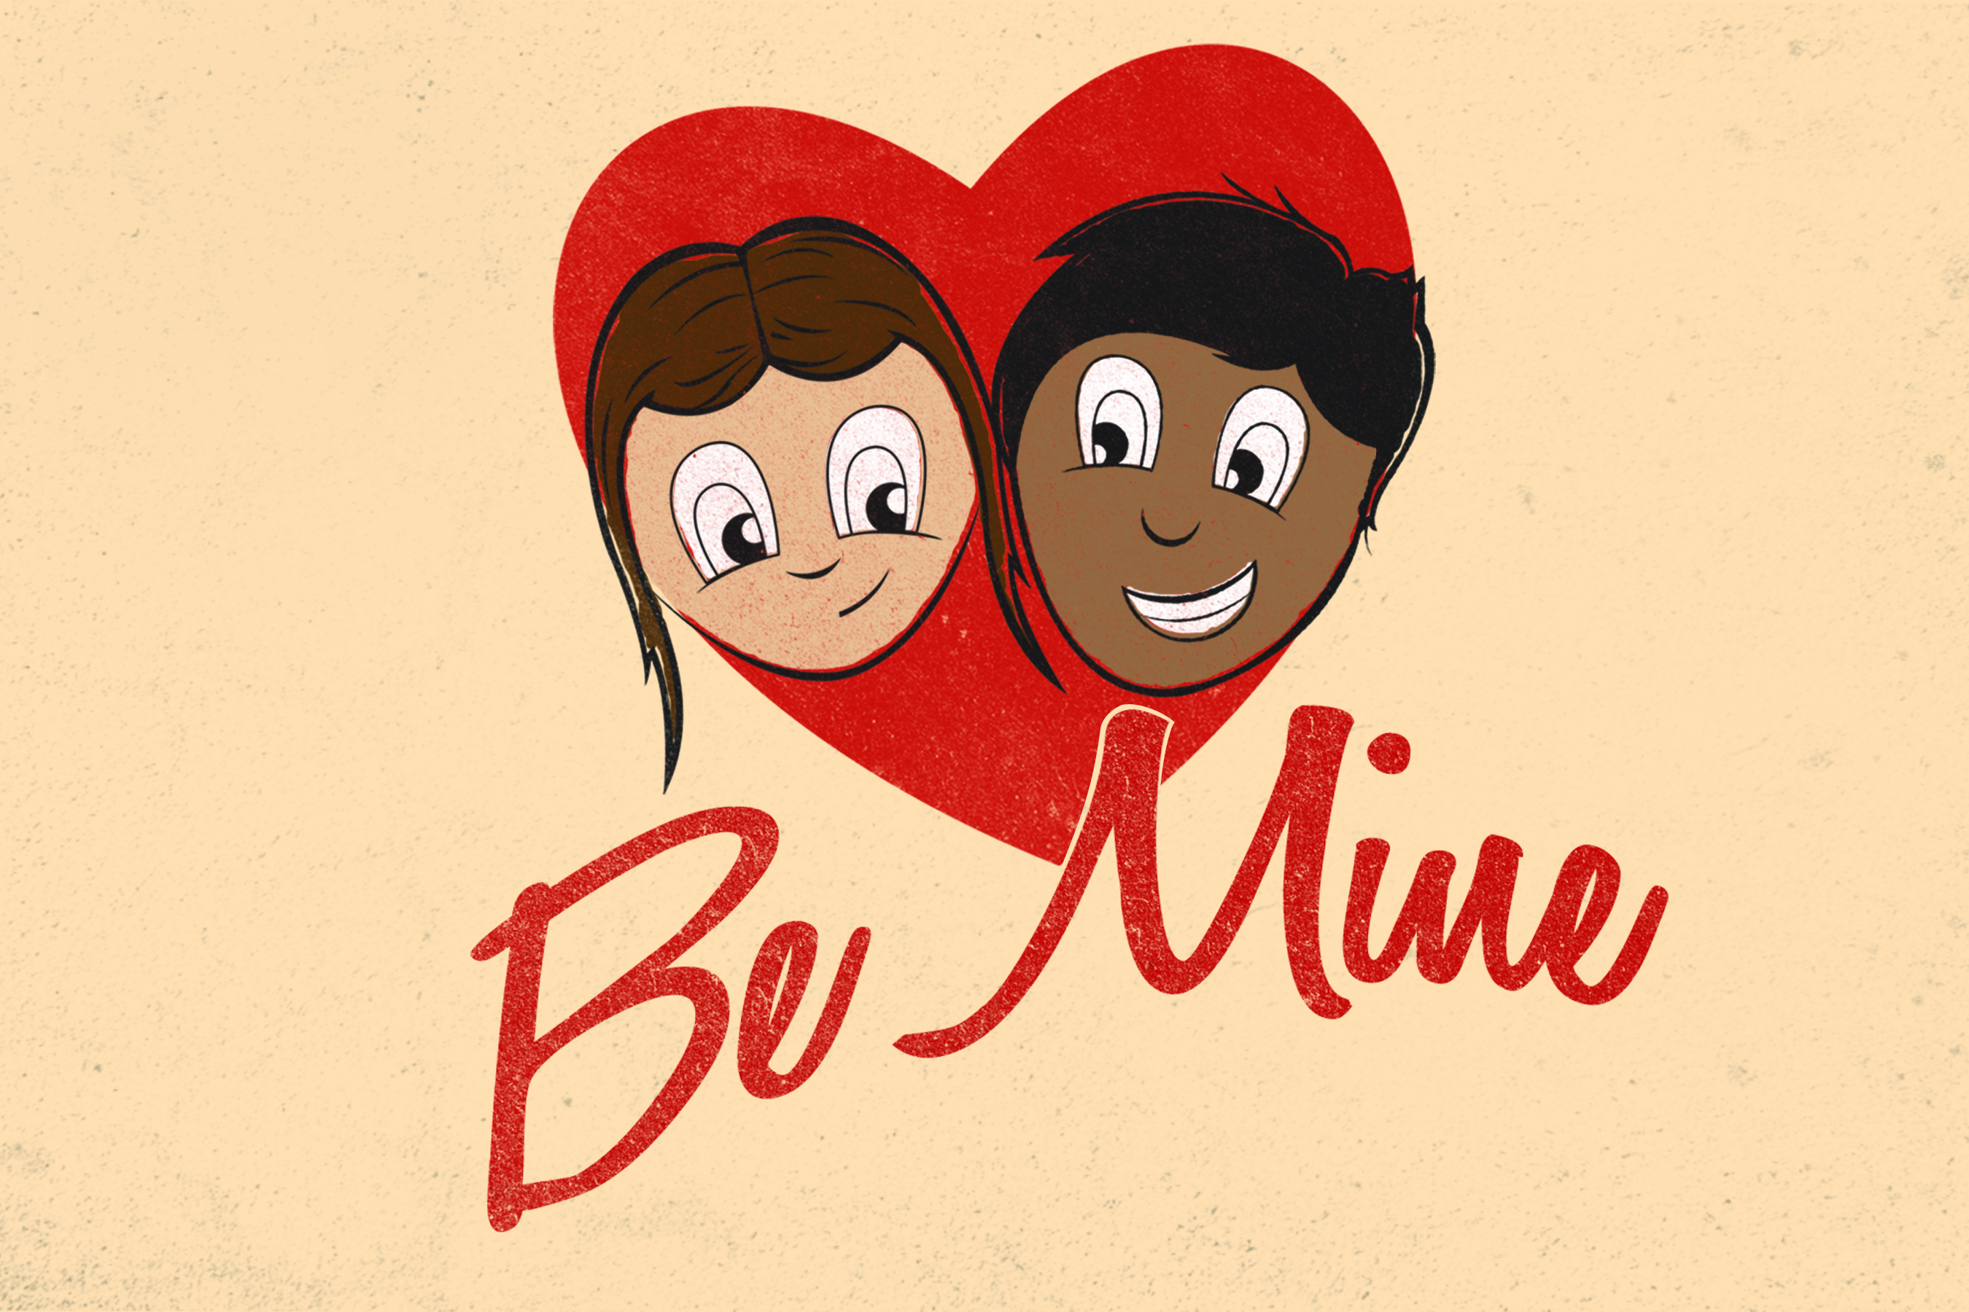

Slide 2
Self Worth
What is Self Worth:
the sense of one's own value or worth as a person; self-esteem; self-respect.
how much One is willing to pay to have something:

Slide 3
Where do you think students today find their self worth?
How about what people think about you/say about you:
When did we start giving people permission to define how we feel about ourselves

Slide 4
What would happen if you found your selfworth in something that never changes?
What would happen if you found your selfworth in someone
  who will always be with you and
  stick with you no matter how your attitude is/
  how ugly/goodlooking you think you are?

Slide 5
Romans 5:8
“God demonstrates his own love for us in this: While we were still sinners, Christ died for us.”
  CHRIST died for ALL people
  The ones who already LOVED God
  The ones who couldn’t stand GOD
  We are all EQUAL in Gods eyes

Slide 6
Psalm 139:13-15
¹³ You made all the delicate, inner parts of my body
and knit me together in my mother’s womb.
¹⁴ Thank you for making me so wonderfully complex!
Your workmanship is marvelous—how well I know it.
¹⁵ You watched me as I was being formed in utter seclusion,
as I was woven together in the dark of the womb.

Slide 7
John 3:16
For God so loved the world that he gave his one and only Son that whosoever believes in him shall not perish but have everlasting life.
  God LOVED the WORLD
  No people who are “anymore” valuable than the next
  He LOVES ALL OF YOU
  ALL YOUR “FLAWS” (but to him there are NONE) ☺

Slide 8
HOW VALUABLE are you?
God loves you enough to GIVE up HIS SON for you
  No respector of people
  ANYONE can receive Salvation / whether you hated God before / hate God now and tomorrow you change your heart

